Slide 1
RESEARCH PROJECT REPORT IN FULFILMENT OF SUMMER INTERNSHIP PROJECT
TOPIC:
ANSOFF’S MATRIX
SUBMITTED BY: SUBMITTED TO:
Saniya Usmani Shashwat Singhal

Slide 2
What is Ansoff's Matrix?
Developed by Igor Ansoff in 1957.
A strategic planning framework used to identify business growth opportunities.
Helps organizations decide how to grow by considering products and markets.
Focuses on balancing growth with risk.

Slide 3
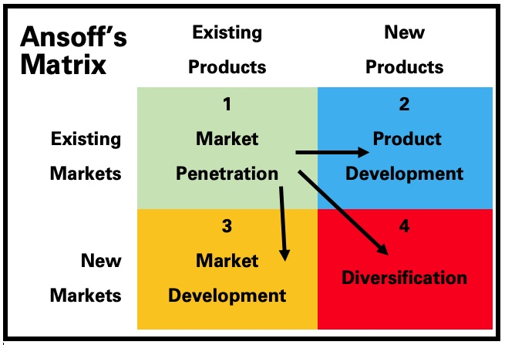
ANSOFF’S MATRIX

Slide 4
Ansoff Matrix Framework
The Ansoff Matrix Framework
Existing Products | New Products
Existing Markets | Market Penetration
New Markets | Market Development

Slide 5
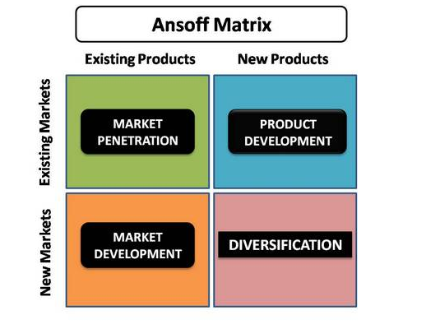
The Four Growth Strategies
Market Penetration
Product Development
Market Development
Diversification

Slide 6

Market Penetration
Selling More Existing Products in Existing Markets
Objectives:
Increase market share
Attract competitors' customers
Encourage repeat purchases
Strategies:
Price discounts
Advertising campaigns
Customer loyalty programs
Improved customer service
Example:
Coca-Cola increases sales through promotions and marketing.
Risk Level: Low

Slide 7
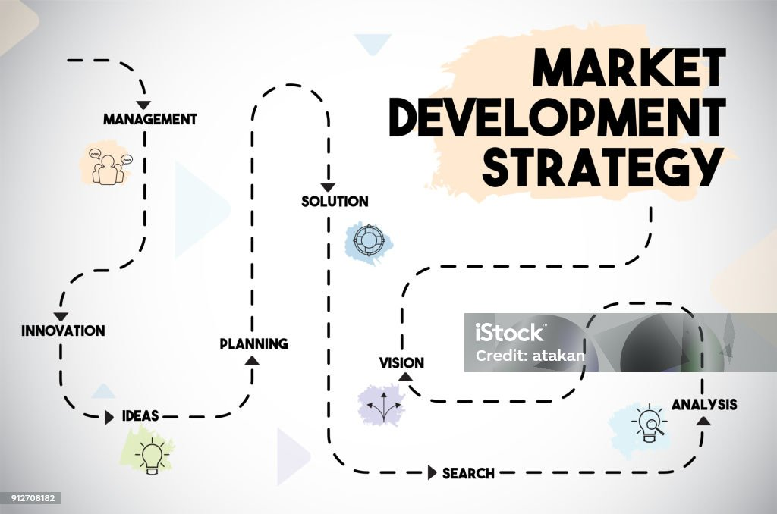
Market Development
Selling Existing Products in New Markets
Methods:
Enter new countries
Target new customer segments
Use new distribution channels
Example:
Starbucks expanding into new international markets.
Advantages:
Increased customer base
Higher sales opportunities
Risk Level: Medium

Slide 8
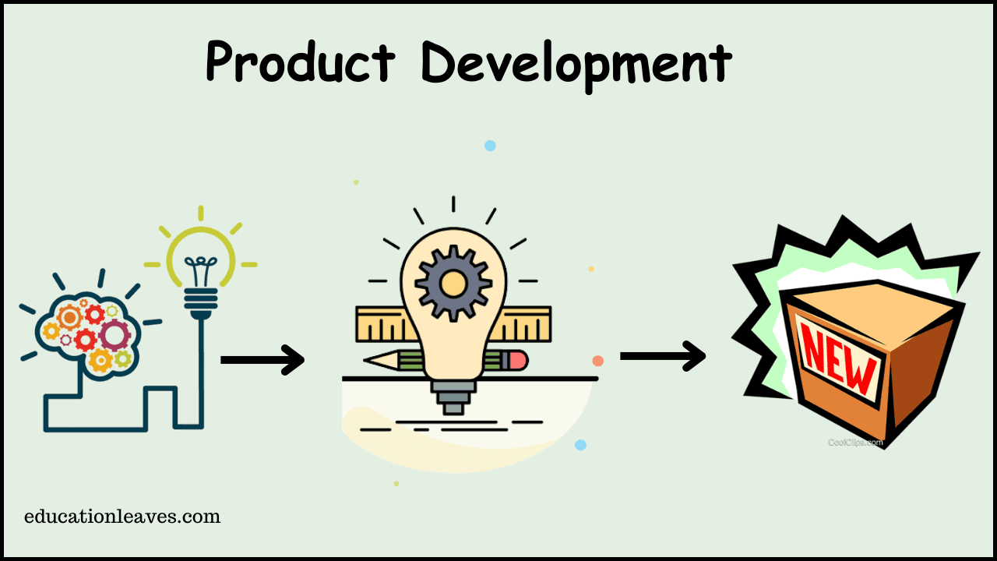
Product Development
Introducing New Products to Existing Markets
Strategies:
Launch improved products
Add new features
Develop product variations
Example:
Apple releases new versions of the iPhone each year.
Benefits:
Meets changing customer needs
Strengthens brand loyalty
Risk Level: Medium to High

Slide 9

Diversification
New Products in New Markets
Types:
Related Diversification
Unrelated Diversification
Example:
Amazon expanding from online books to cloud computing (AWS).
Advantages:
Multiple revenue sources
Reduced dependence on one market
Disadvantages:
High investment
Greater uncertainty
Risk Level: High

Slide 10
Advantages and Limitations
Advantages
Easy to understand
Supports strategic planning
Helps evaluate growth opportunities
Encourages long-term thinking
Limitations
Does not consider competition
Ignores external environmental factors
Success depends on market research and execution

Slide 11
Real-World Applications
Real-World Applications
Many companies use Ansoff's Matrix:
These examples show how businesses choose different growth strategies based on their goals and market conditions.
Company | Strategy
Coca-Cola | Market Penetration
Starbucks | Market Development
Apple | Product Development
Amazon | Diversification

Slide 12
CONCLUSION
Ansoff's Matrix is a valuable strategic planning tool.
It identifies four business growth strategies:
  Market Penetration
  Market Development
  Product Development
  Diversification
Businesses should choose strategies based on objectives, resources, and risk tolerance.

